Slide 1







TECHNOLOGY TREND ANALYSIS REPORT: STACK OVERFLOW DEVELOPER SURVEY 2019
UTKARSH RAJ
17/10/2022

Slide 2



OUTLINE
Executive Summary
Introduction
Methodology
Results
Visualization – Charts
Dashboard
Discussion
Findings & Implications
Conclusion
Appendix

Slide 3

EXECUTIVE SUMMARY
The following slides summarize key findings from an analysis of data collected as part of the 2019 Stack Overflow Developer Survey.
This report gives insights regarding:
Most popular Developer technologies (Webframe, Platforms, Languages and Databases) trending
Which Developer technologies will become most popular in the future.
Demographical analysis of Developers based on Age,Country ,Gender and Education level

Slide 4

INTRODUCTION
• The online programming knowledge sharing platform, Stack Overflow, has been conducting the Annual Developer Survey to empower Developer Technologies development
• Purpose of this Analysis
• Identify the top programming languages, database, platform and web frame skills in demand
• Identify skill requirements for future
• Identify human resource gap in the industry
• Size of subset : N= 11,398
• Audience for this Presentation
• Programmers
• IT industry leaders
• Computer science students

Slide 5

METHODOLOGY
• Data Collection (Sources)
• Stack overflow developer 2019 survey
• GitHub job postings
• Programming languages annual salary
• Data Wrangling:
A portion of the dataset (provided by IBM) was loaded and cleaned using SQL and Python’s pandas library.
• Data Cleaning procedure:
Duplicates removal, data imputation, data normalization
• Data Exploration & Data Visualization
EDA and data visualization were conducted using various Python libraries and Cognos. Specifically, the following measures were examined:
• Technologies trending
• Technologies most desired for the next yea
• Demographics (i.e., gender, country, age, and education)
• Presentation

Slide 6
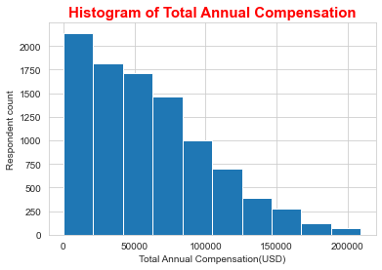
RESULTS:
Descriptive statistics regarding demographics and total annual compensation were computed.
• Sample size after compensation outlier removal: N = 10,519
(before removal: N = 11,398, Number of outliers = 879).
• The respondents median age = 29,
Male percentage = 93.5 %
Female percentage = 6.5 %
• Median compensation: $52,704 USD per year.
• Compensation and Age were positively correlated: r = 0.40.
• Median compensation was higher for women: $54,956 than men: $52,339

Slide 7
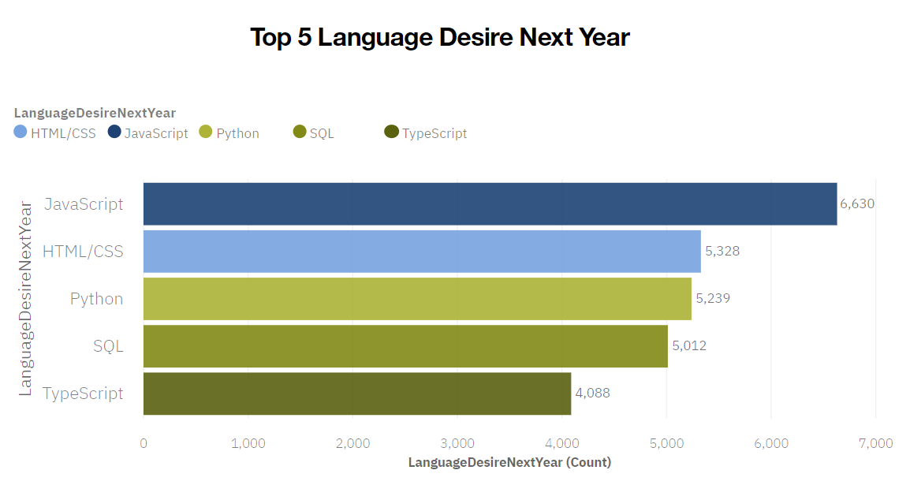
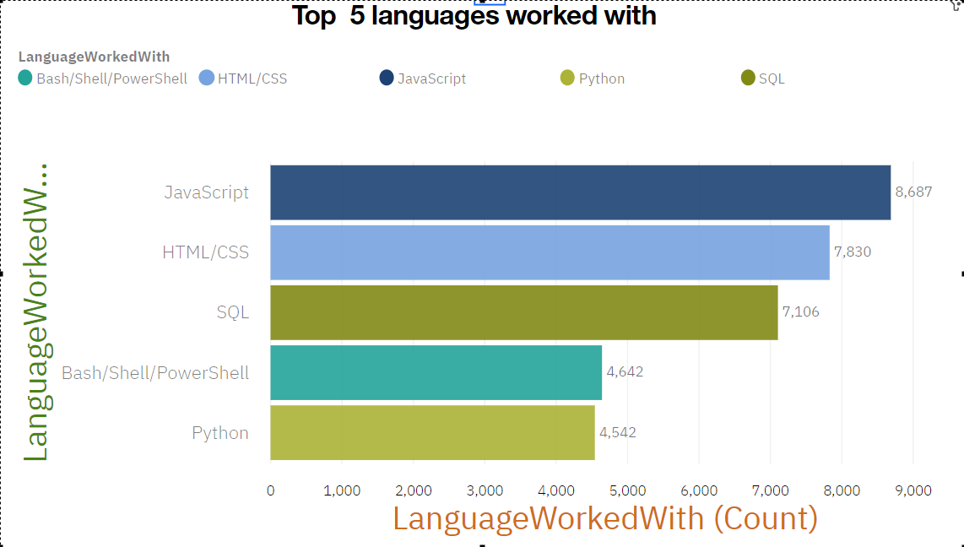
PROGRAMMING LANGUAGE TRENDS(Top5):
Current Year
Next Year

Slide 8
PROGRAMMING LANGUAGE TRENDS - FINDINGS & IMPLICATIONS
Findings
• Javascript & HTML/CSS were the most popular in 2019 and also most desired in following year
• SQL was popular in 2019 and will likely remain so.
• There is significantly increasing interest in python and typescript.
• Interest in PowerShell/Bash is decreasing.
Implications
• With Javascript and HTML/CSS keep being dominant languages Web development is still in high demand. However, TypeScript is ascending higher & may catch up in the future.
• SQL remains the preferred language for big data storage and querying.
• Python’s rising popularity likely reflects the growth of AI and ML work.

Slide 9
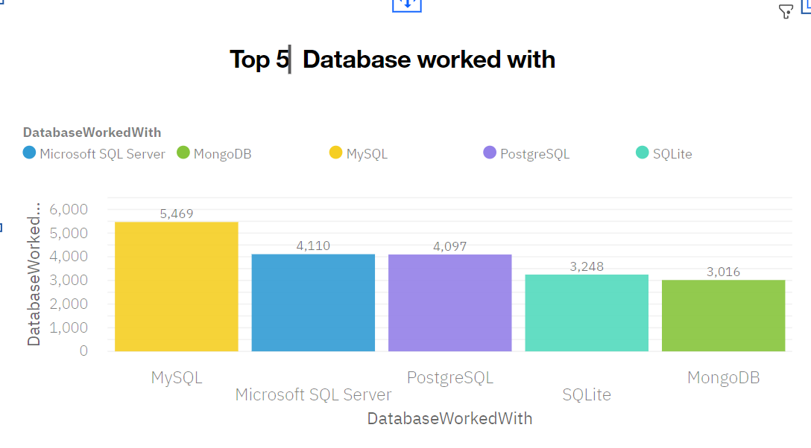
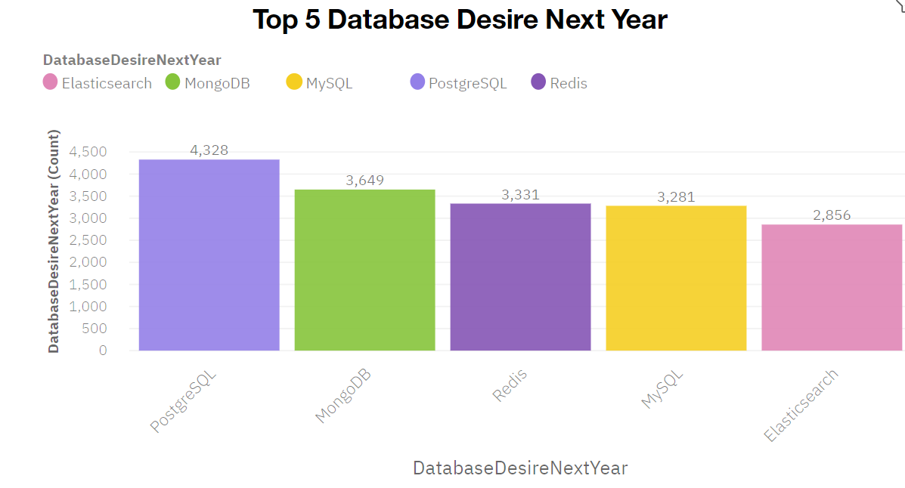
DATABASE TRENDS
Current Year
Next Year
< Bar chart of top 5 databases for the current year goes here >

Slide 10
DATABASE TRENDS -FINDINGS & IMPLICATIONS
Findings
• SQL database programs were the most popular in 2019, with MySQL in the lead.
• MongoDB was popular in 2019 and ascending in popularity.
• The popularity of PostgreSQL is growing over other SQL database programs and it was the overall most desired database for the next year.
• Increasing interest in Elasticsearch making it in top 5 most desired
Implications
• The preference for open-source database programs appears to be increasing among developers.
• In addition to SQL database programs, current and aspiring data analysts should develop skills in NoSQL.
• NoSQL database programs are gaining popularity, which likely reflects a growing need to handle nonrelational and unstructured data.

Slide 11

DASHBOARD
The following link contains the full, interactive Cognos dashboard summarizing
Current technology use,
Future technology trend, and
Demographics of the survey respondents:
Dashboard link

Slide 12
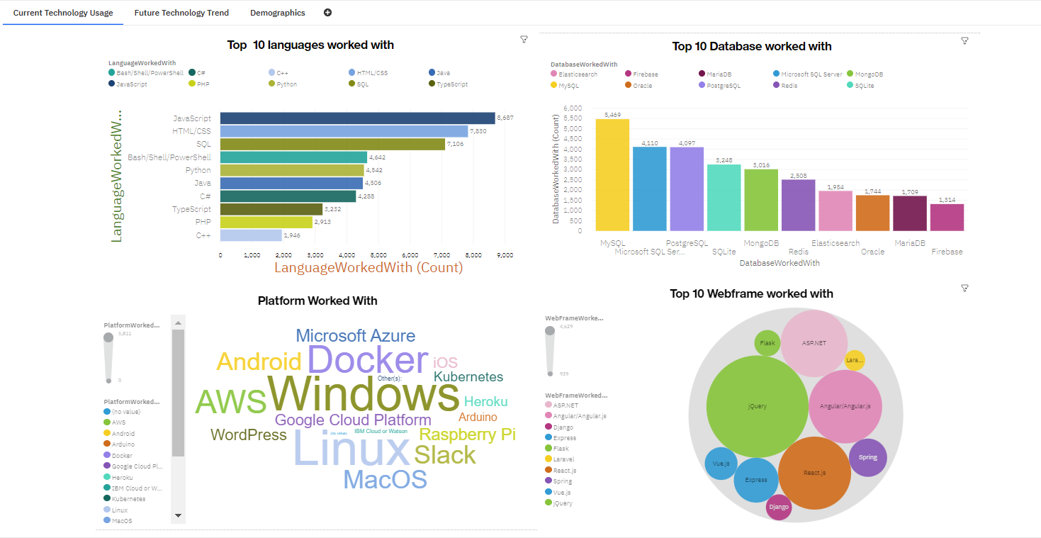
DASHBOARD TAB 1:Current usage

Slide 13
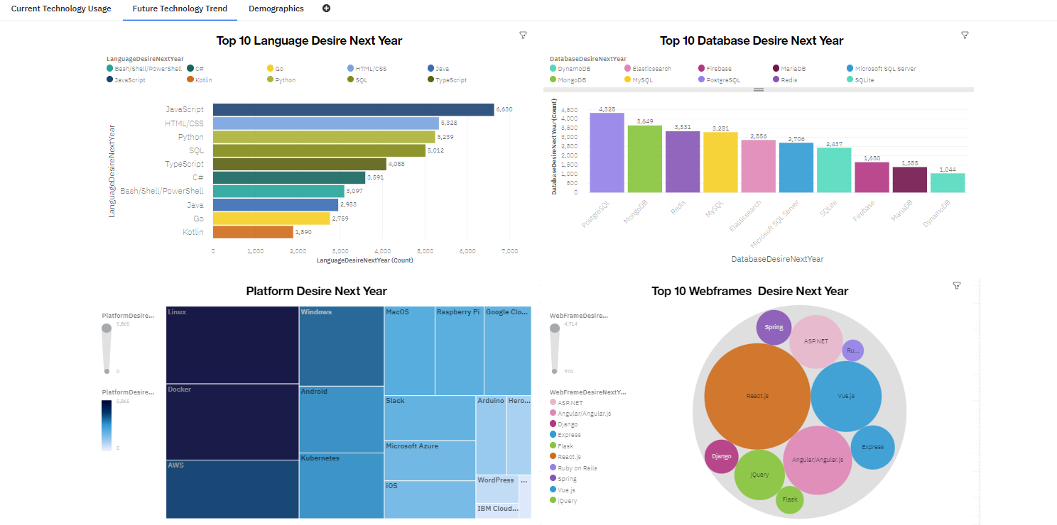
DASHBOARD TAB 2:Future usage
Screenshot of dashboard tab 2 goes here

Slide 14
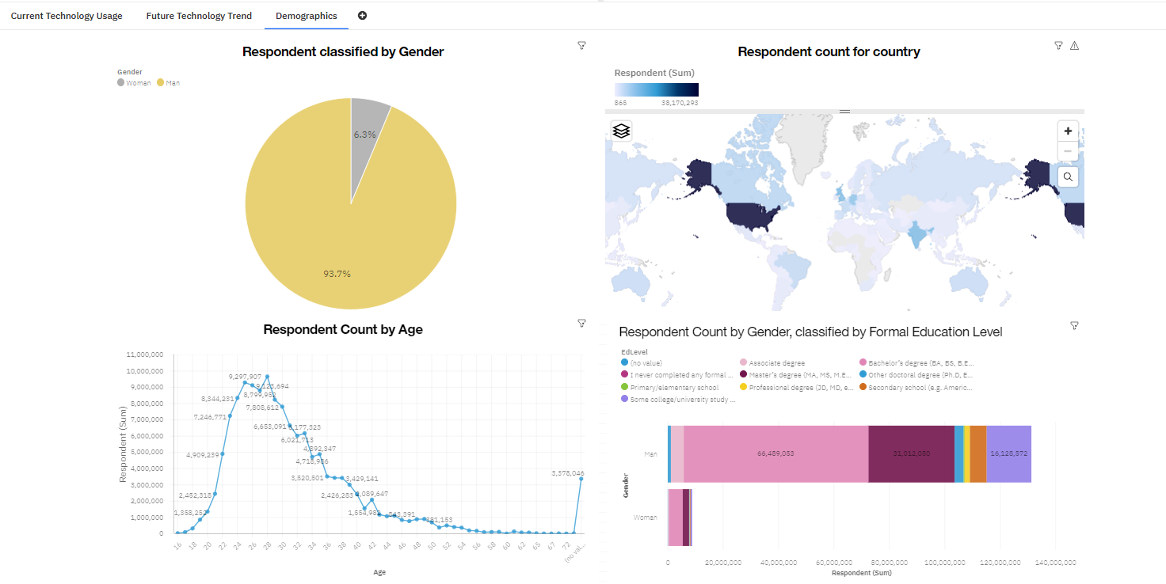
DASHBOARD TAB 3: Demographics

Slide 15
DISCUSSION
Taken together, the findings yield insights into the following questions:
• What kinds of developer technologies are in top demand?
• Which technologies should prospective developers and data professionals be learning?
• Which technologies should educators place more emphasis on teaching in upcoming years?
• What does the distribution of annual compensation for developers look like?
• What is the developer demographic like? Is there a gender representation gap?

Slide 16
OVERALL FINDINGS & IMPLICATIONS
Findings
• Javascript/HTML is most used and there is high interest in following year as well. There’s also growing interest in Typescript.
• Increasing interest in Python.
• High usage and interest in SQL .MySQL had the highest usage in 2019
• PostgreSQL is gaining interest and was the overall most desired database program for the next year
• NoSQL database programs gaining interest, of which MongoDB was the most used in 2019 and desired for the next year.
• A severe gender representation gap (in favor of men), despite median compensation being slightly higher for women.
• Technology divide between countries.
Implications
• Web development is still in high demand. Current and prospective developers may consider picking up Typescript in addition to Javascript and HTML/CSS.
• With the growing need to handle big data and perform AI and ML work, data professionals should continue to enhance SQL competence but also enhance competence with NoSQL database programs and Python.
• Businesses need to adapt to changing technology preferences, especially in terms of talent acquisition and development.
• Policy makers, educators, and organizations should work to minimize the gender representation gap in addition to the technology divide between countries.

Slide 17

CONCLUSION
A subset of data collected as part of the 2019 Stack Overflow Developer Survey was examined.
The findings yielded numerous insights into the technologies most used and desired by developers in addition to the developer demographic.
These insights should be particularly relevant for
Current and prospective developers aiming to remain competitive,
Businesses aiming to upskill their talent,
Educators in the field, and policy makers aiming to address gender and economic issues.

Slide 18
APPENDIX A: JOB POSTINGS
In Module 1 you have collected the job posting data using Job API in a file named “job-postings.xlsx”. Present that data using a bar chart here. Order the bar chart in the descending order of the number of job postings.

Slide 19
POPULAR LANGUAGES
In Module 1 you have collected the job postings data using web scraping in a file named “popular-languages.csv”. Present that data using a bar chart here. Order the bar chart in the descending order of salary.

